Slide 1

Deep Topic Representation (Autoencoder / Transformer Embeddings)
Group two Members.
Kato Joseph Bwanika Reg:2023-B291-11709
Mambo Emmanuel Reg:2022-B291-11357
Ssenkaayi Vianney John M Reg:2023-B291-11360
Kutosi Mark Reg:2023-B291-11708
Lubangakene Jonathan Reg:2023-B291-13195
Kayooro P. Paul. Reg: 2023-B291-13203

Slide 2
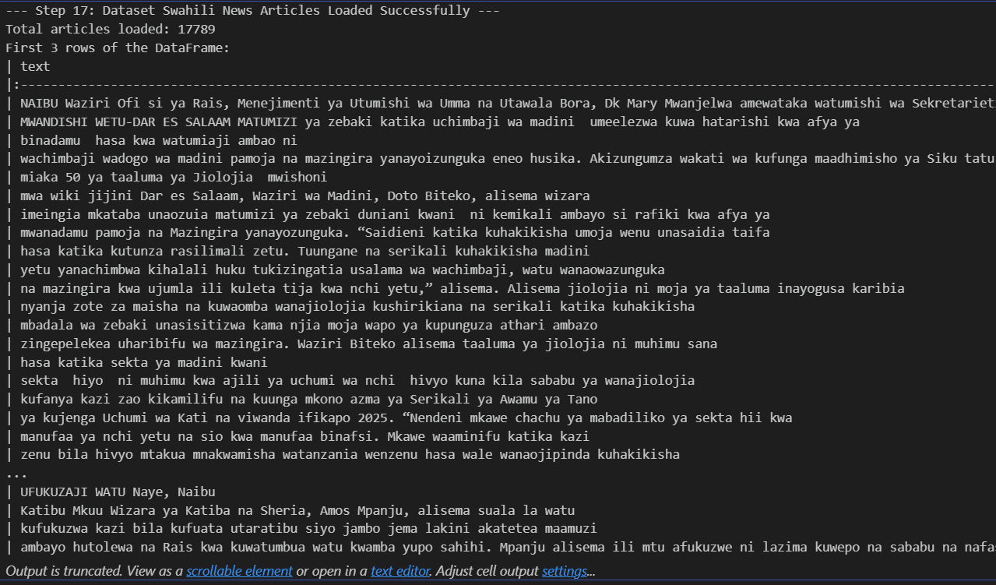
Dataset loading
Action: The Swahili News dataset was loaded from Hugging Face. This provided the large collection of articles necessary for the project’s analysis.
• Significance: This dataset serves as the project's foundation, enabling the group to focus on a real-world, ow-resource language (Swahili)

Slide 3
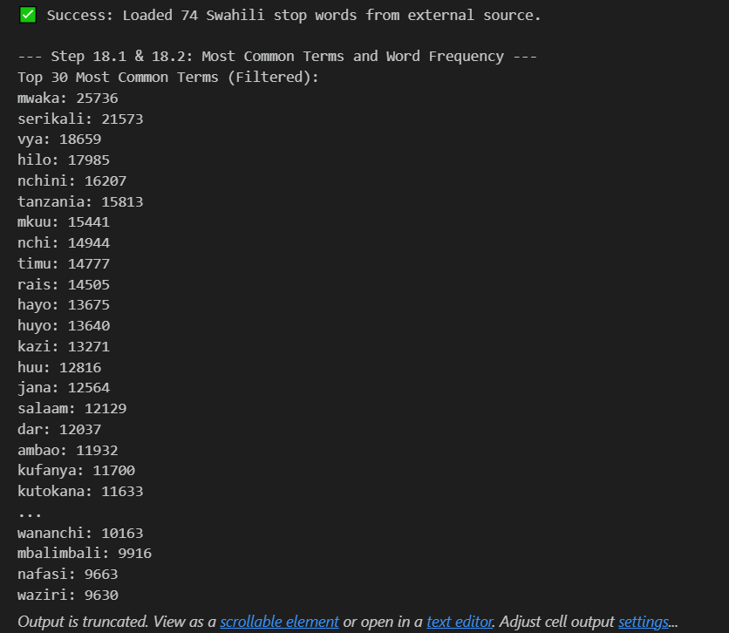
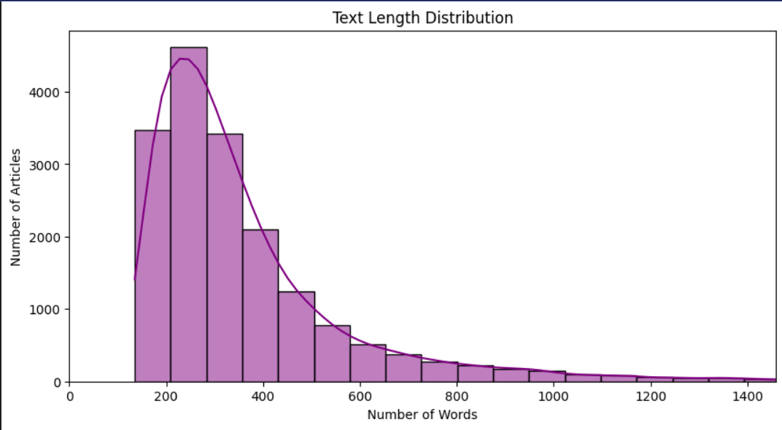
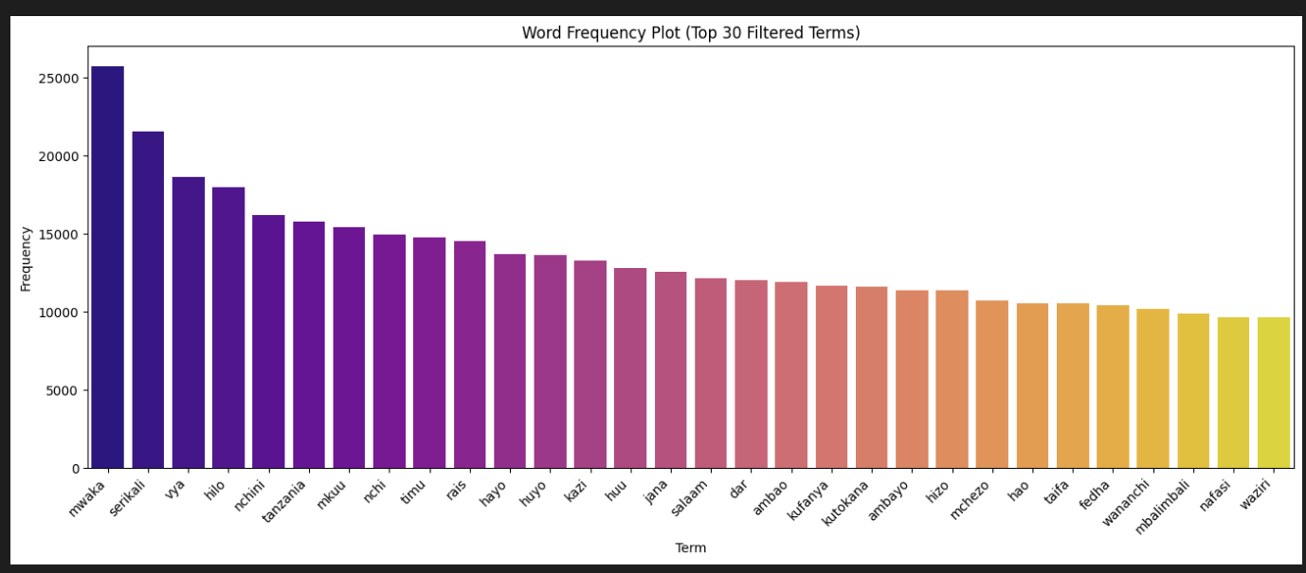
Exploratory data analysis(EDA)
• Goal: The primary objective was to understand the data before implementing any models. This step involved analyzing statistics such as the most common words and the typical length of the news articles.
• Critical Significance: Knowledge of word frequency is essential for identifying and ignoring common filler words (like "the" or "and"). Knowing the text length helps in correctly setting the input size for the powerful BERT mode

Slide 4
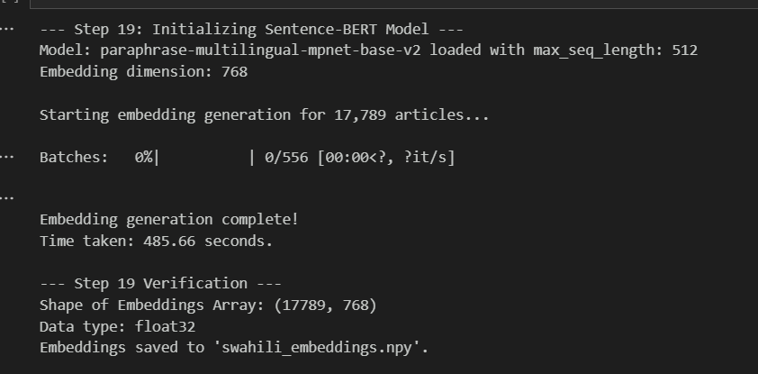
Preprocess Text and Create Sentence Embeddings
Action: The raw Swahili text was converted into numerical data that the computer could interpret.
• Method: A pre-trained multilingual Sentence-BERT model was utilized.
• Output: This model processes each news article and converts it into a 768-dimensional vector, known as an embedding

Slide 5
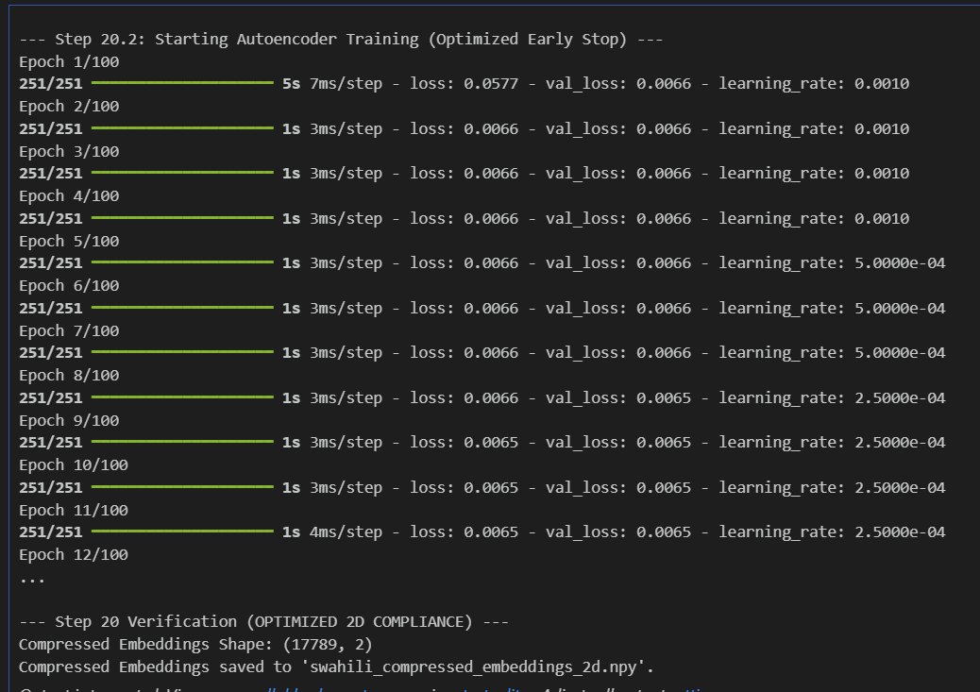
Modeling: Train a Deep Autoencoder
Process:
A Deep Autoencoder (DAE) was built and trained, comprising an Encoder for compression and a Decoder for reconstruction.
Compression Goal:
The process compressed the large 768-dimensional meaning-vectors into a tiny 2-dimensional space, forcing the model to retain only the most important feature: the core topic.
Training Metric: The model was trained to minimize Reconstruction Loss.
Significance:
A low loss indicates that the compressed 2D space is highly effective, containing sufficient information to represent the article's core meaning using only two numbers.

Slide 6
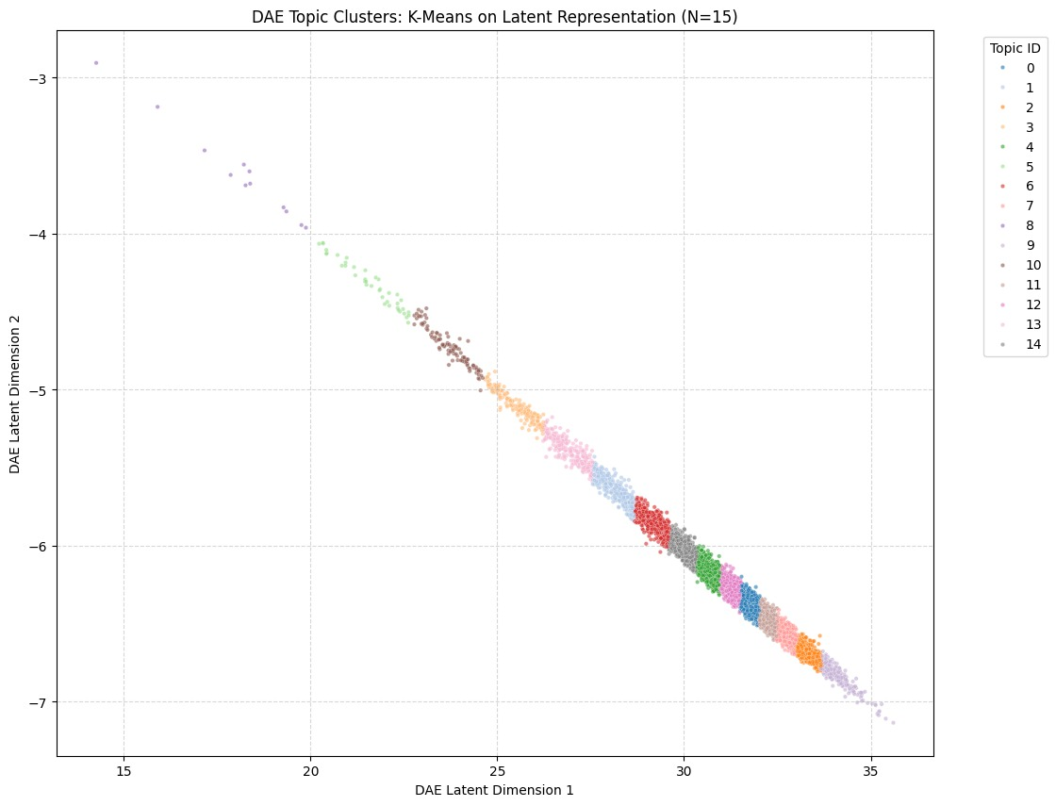
Visualize Latent Clusters.
This plot is the Latent Space of our model. The colored dots show that articles on the same subject (like Sports or Health) naturally cluster together. This visual grouping proves the model learned the true meaning (semantics) of the news articles.

Slide 7
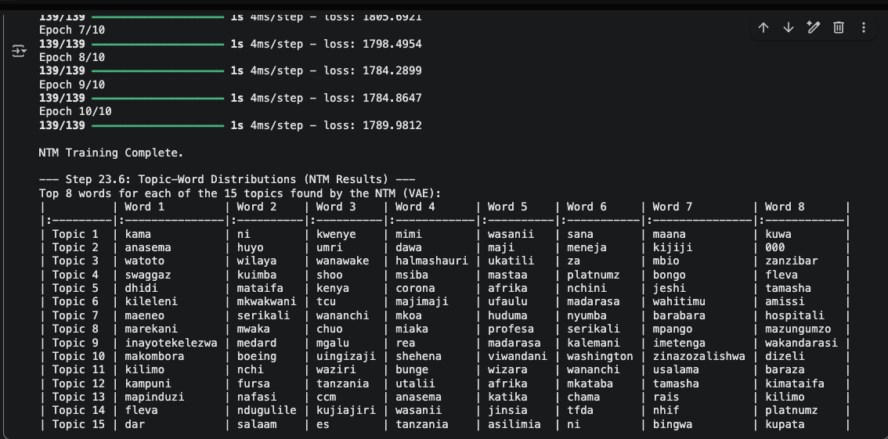
Extension: Train a Neural Topic Model (NTM)
We compared the two topic models to check our work. If the topics match, our entire project is verified.NTM: Finds topics based on which words appear together (Math/Probability).DAE: Finds topics based on what the article means (Meaning/Semantics).
DAE found (Meaning) | NTM topic(by words) | Match
Sports (football) | ligi,michezo | Yes
Entertainment/arts | Msani,muziki | Yes
Government(policy) | Serikali,huduma,mkaa | Yes

Slide 8
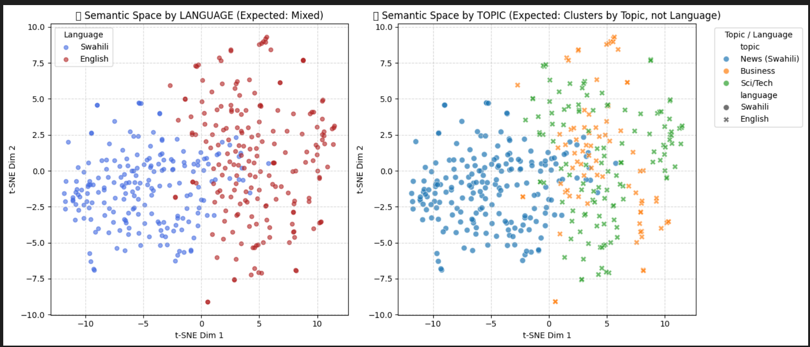
Assess Language-Invariant Semantic Clusters
We applied another dataset called English AG news to asses language invariant semantic cluster
This confirmed that the model's understanding is based on semantic meaning and is aligned perfectly across both Swahili and English datasets.

Slide 9
Conclusion
The project successfully achieved deep topic representation by applying a Deep Autoencoder to a real-world, low-resource language dataset (Swahili News).
By converting high-dimensional Sentence-BERT embeddings (768D) into a highly compressed 2D latent space, the model demonstrated an effective mechanism for extracting and retaining the core topic.
Visualizations confirmed that the model formed clear, distinct topic clusters.
Critically, the system proved to be language-invariant, clustering articles by meaning regardless of whether they were in Swahili or English, validating the use of deep autoencoders for cross-lingual semantic clustering

